Slide 1
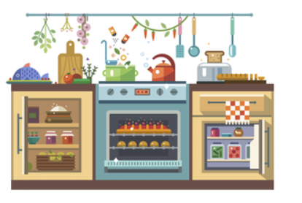
What’s Cooking?
Lab Group - FS3
Team Number 1
Members - Mundhra Divyesh, Kar Aik, Cheyanne

Slide 2
Project Objective:
Linking different type of Cuisines based on the similarity of the top ingredients in each cuisine using a Network Plot.
Through the network plot, get an idea about the Origin of each type Cuisine and how are they Related to each other.
Using Machine Learning with Random Forest Classifier and Classification Tree to predict the cuisine type to which a particular set of ingredients belong to.

Slide 3
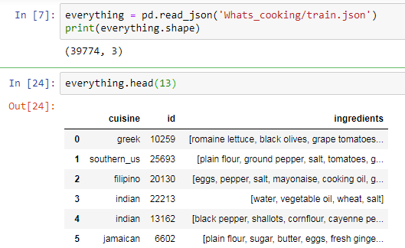
Reading the file:
What’s Cooking DataSet from
The dataset has 39774 rows and 3 columns.
.

Slide 4
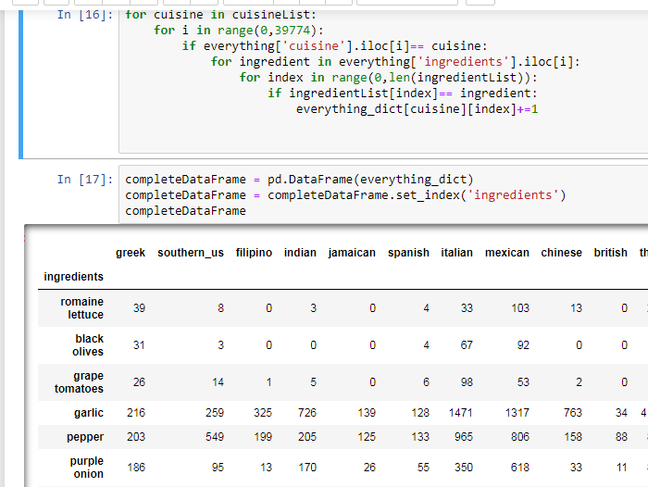
Displaying and Cleaning the
Data set :
Displays number of times an ingredients is used per Cuisine.
Dropping common ingredients
Salt, water, onions, sugar etc...

Slide 5
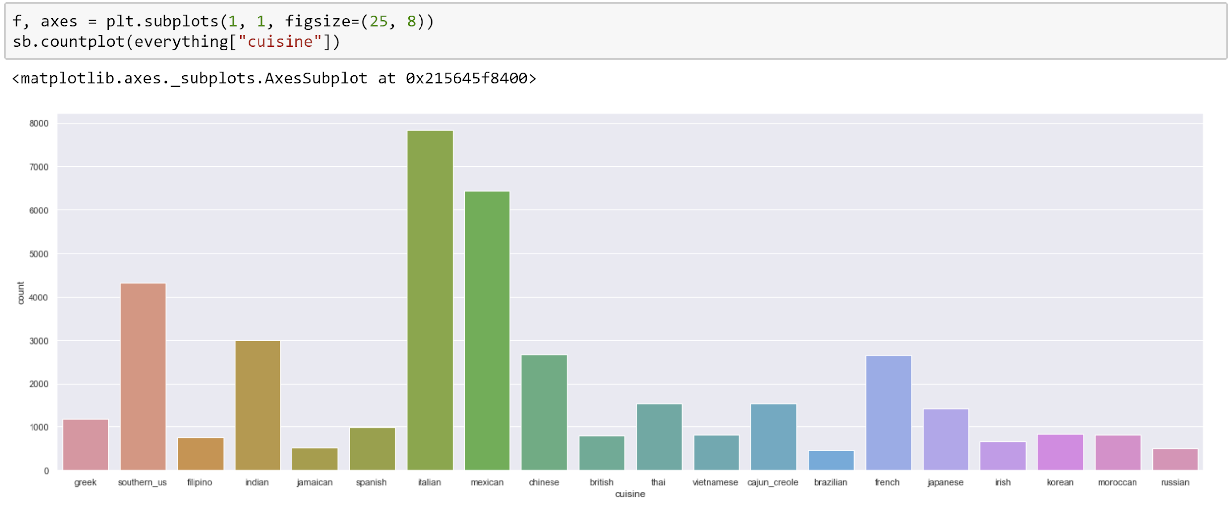
Data Exploration:
We have a Histogram which gives the number of unique ingredients used in each type of cuisine.

Slide 6


Visualization of the Data

Slide 7
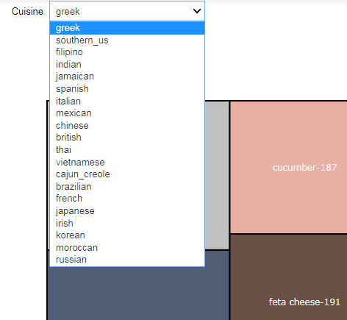
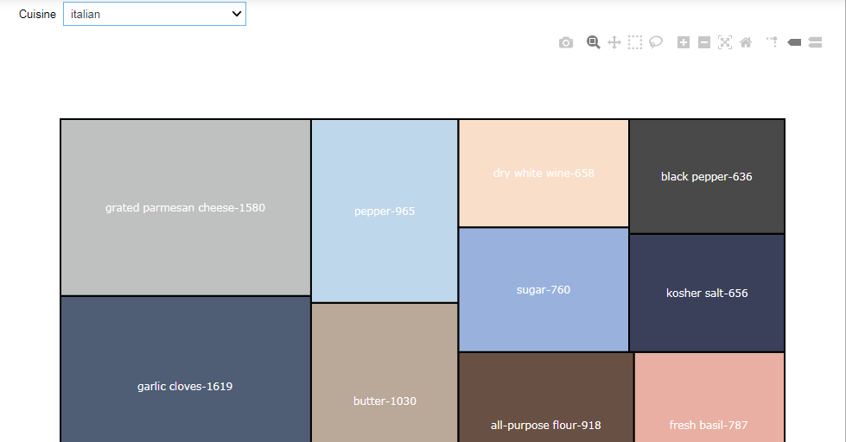
Drop down Menu to choose a particular Cuisine.
Display of a Tree map for the top 15 ingredients used per Cuisine

Slide 8
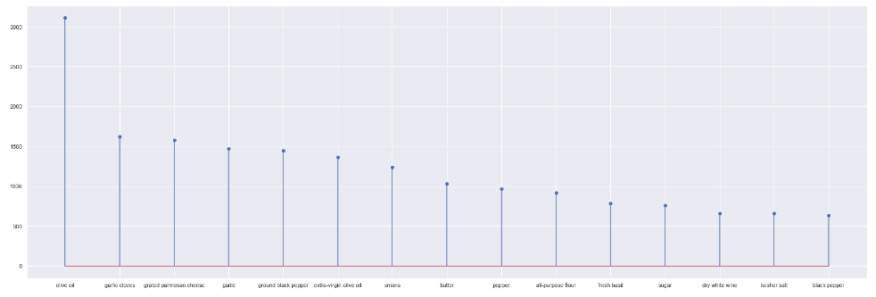
Drop down Menu to choose a particular Cuisine.
Display of a Lollipop Graph for the top 15 ingredients used per Cuisine

Slide 9
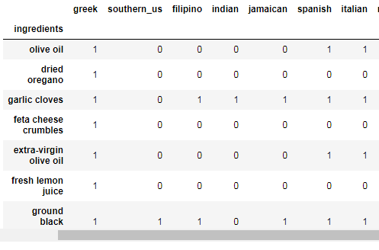
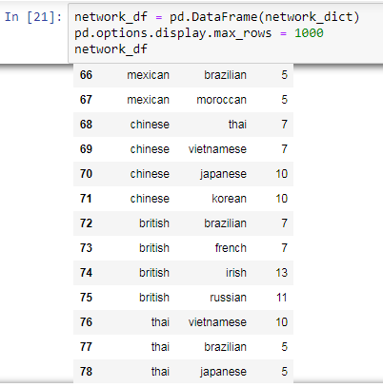
From the previous DataFrame, we further created 2 more DataFrame
showing presence of ingredients in each of the given Cuisines
showing the number of common ingredients between each pair of Cuisines
Notes:
At least 5 common ingredients

Slide 10
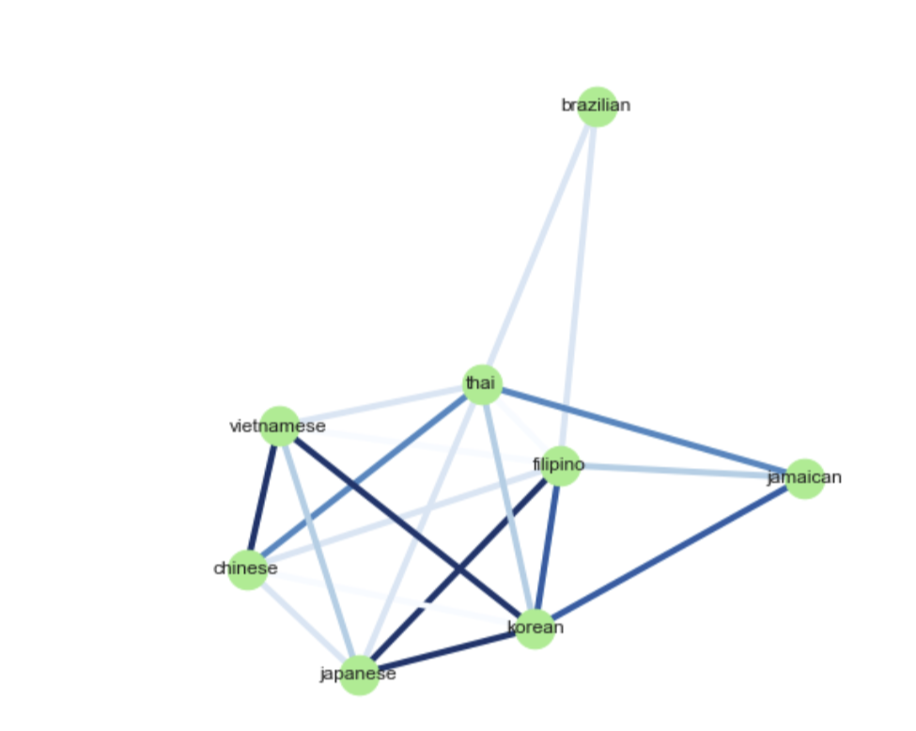
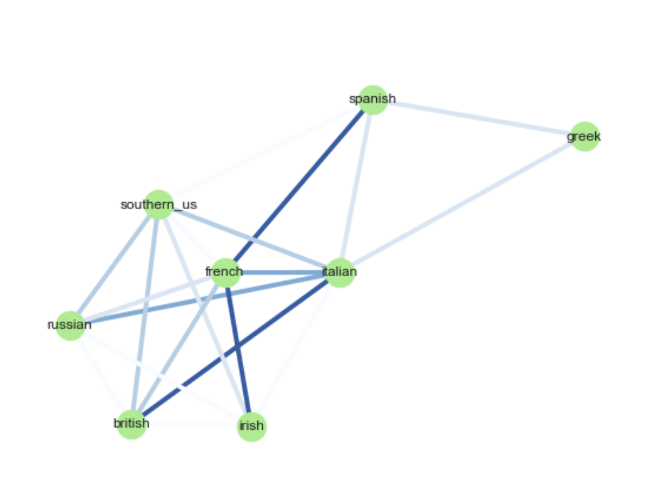
This graph shows the connection between each pair of cuisines based on number of common ingredients.
The shades of colour denotes the number of common ingredients
Notes:
Darker shade denoted more number of common ingredients.

Slide 11
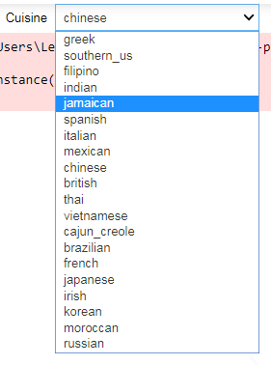
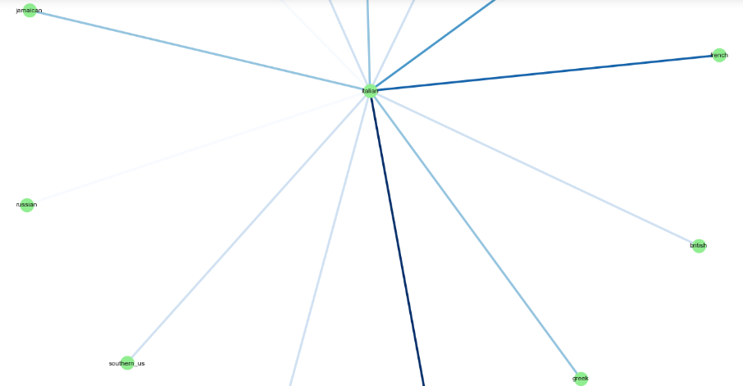
A Drop Down Menu For Each Cuisine
Notes:
This in a way helps us to find out relation between the origin of each type of cuisines and how they are related to each other.
For example irish, british and russian cuisines are related with a darker shade showing they are related closely having a lot of common ingredients. Indian is unique

Slide 12


Machine Learning

Slide 13
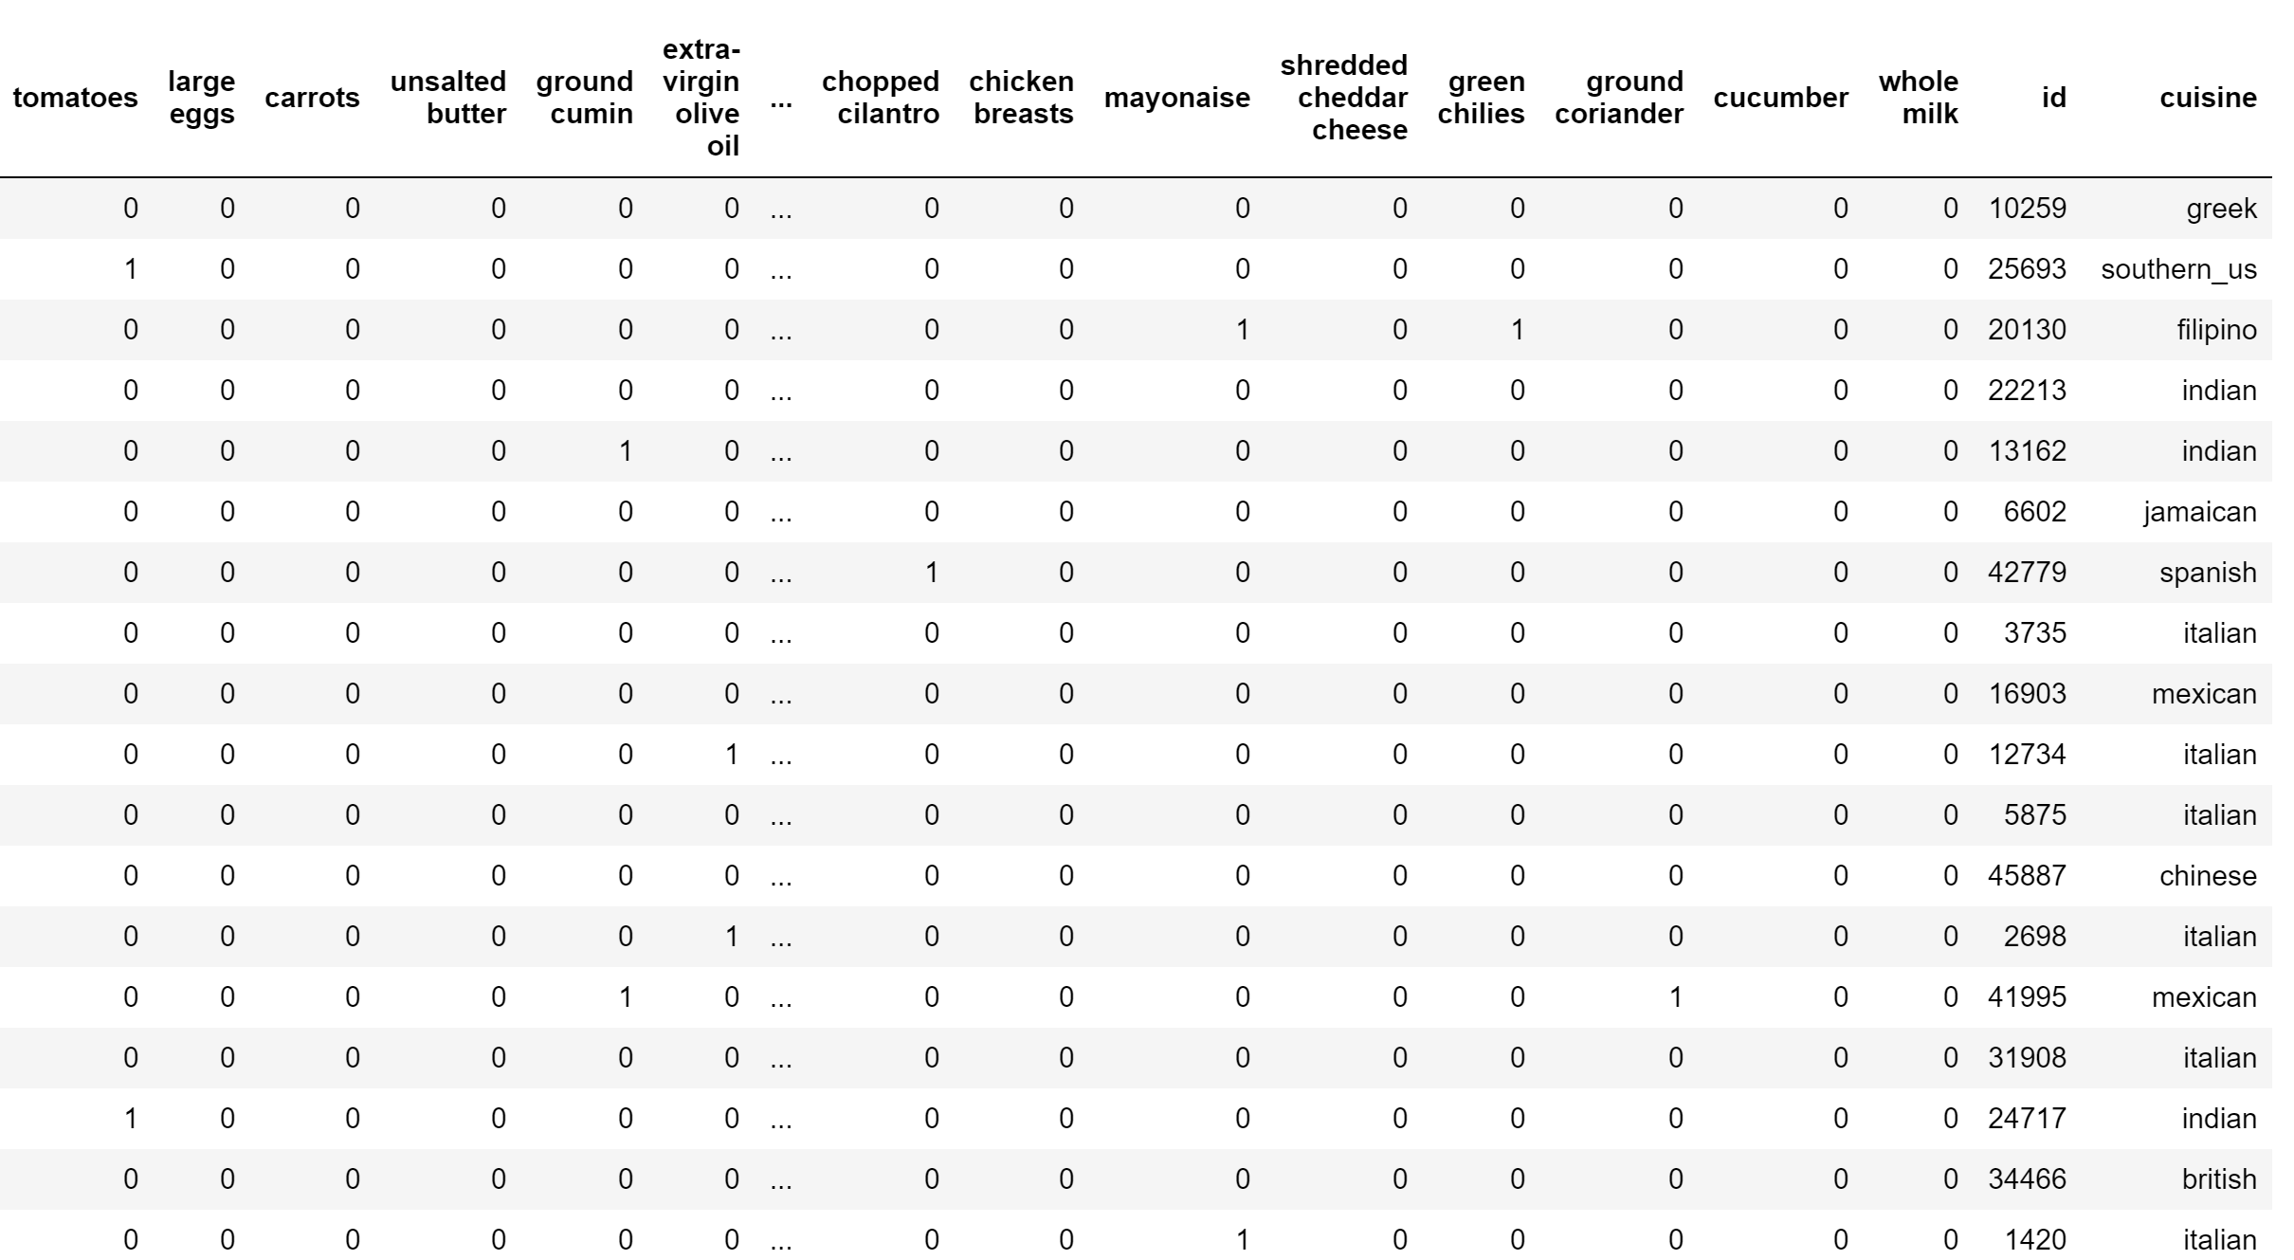
Preparing of Train and Test Dataset
Columns:
Top 100 Ingredients
Id
Cuisine (Except Test)
Each Row Represent Each Recipe

Slide 14
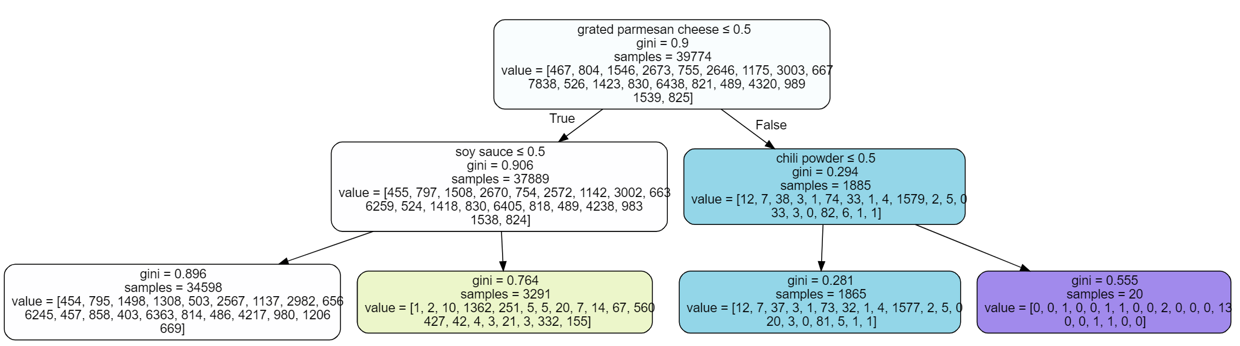
Learning using Classification Tree

Slide 15
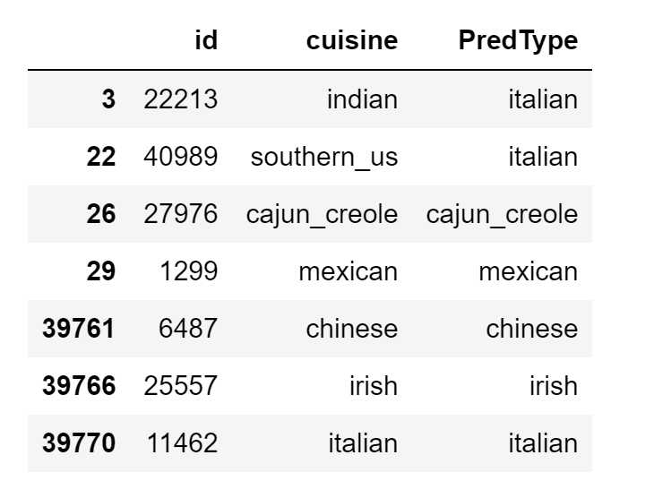
Increasing Max Depth and Predict Train Set
Max Depth:100

Slide 16
Using Random Forest
n_estimator:100

Slide 17
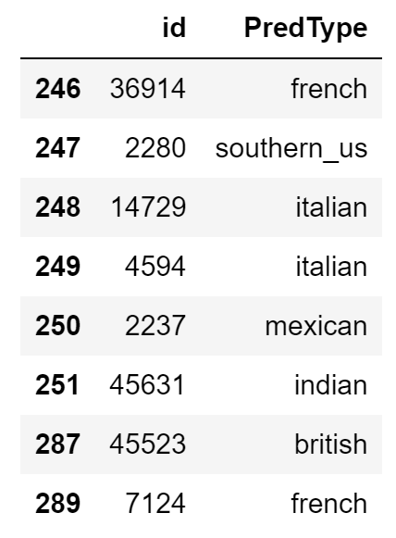
Predict Test Set
Classification
Tree:
Random Forest:

Slide 18
Work Distribution:
Data Exploration and Analysis: Kar Aik,Cheyanne and Divyesh
Preparation of Data Set & Cleaning: Kar Aik and Divyesh
Network Plot Visualization with Dropdown Menu: Cheyanne
Machine Learning using Random Forest: Kar Aik
Presentation Slides: Divyesh And Kar Aik

Slide 19
Thank You!
Q & A

